Slide 1
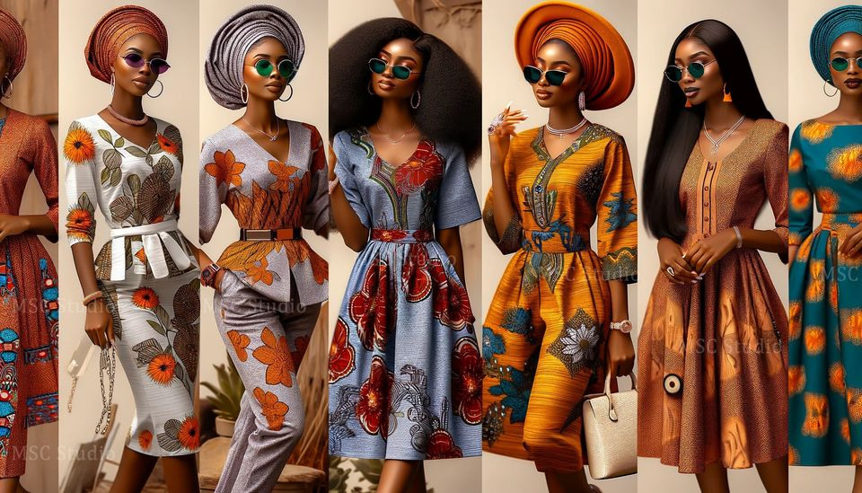
GROUP 2
Personalized virtual fashion recomendation system

Slide 2
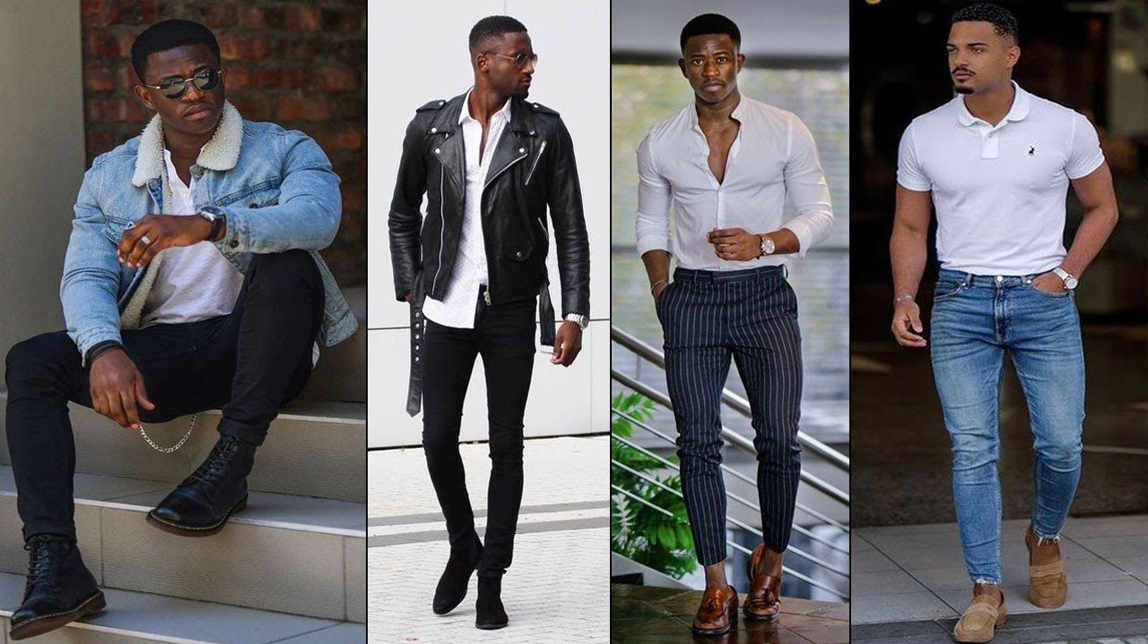
INTRODUCTION
Digital era demands personalized fashion experiences for self-expression.
We are Introducing a system to offer tailored fashion guidance leveraging advanced technology.
Addressing Consumer Needs: Providing personalized recommendations for enhanced shopping experiences and boosted self-confidence.
Enhancing Convenience: Helping users navigate the vast digital fashion landscape effortlessly.

Slide 3
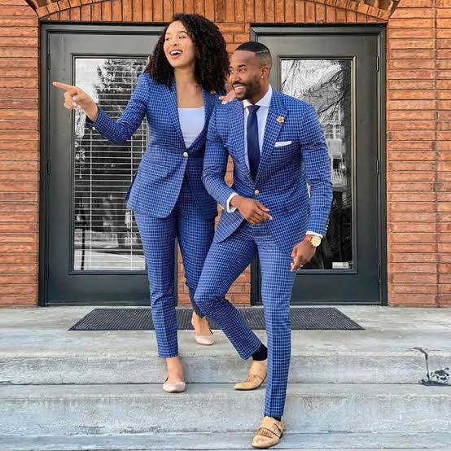
BUSINESS PROBLEM
Digital fashion lacks personalized guidance, impacting user confidence.Absence of tailored styling support limits users' ability to curate cohesive outfits. Addressing these challenges is critical for digital fashion businesses and require strategic solutions.

Slide 4
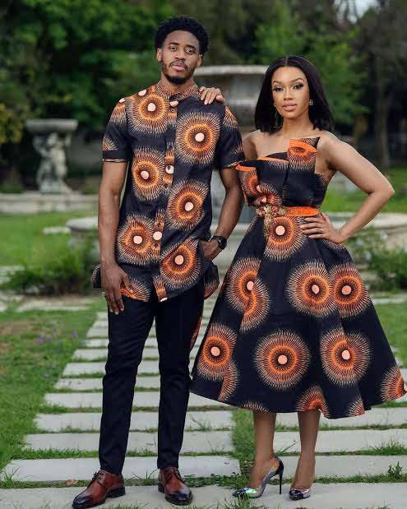
DEPLOYMENT
We used Streamlit application for our web application which allows users to upload an image of a clothing item and receive recommendations for similar items from a dataset of fashion images

Slide 5
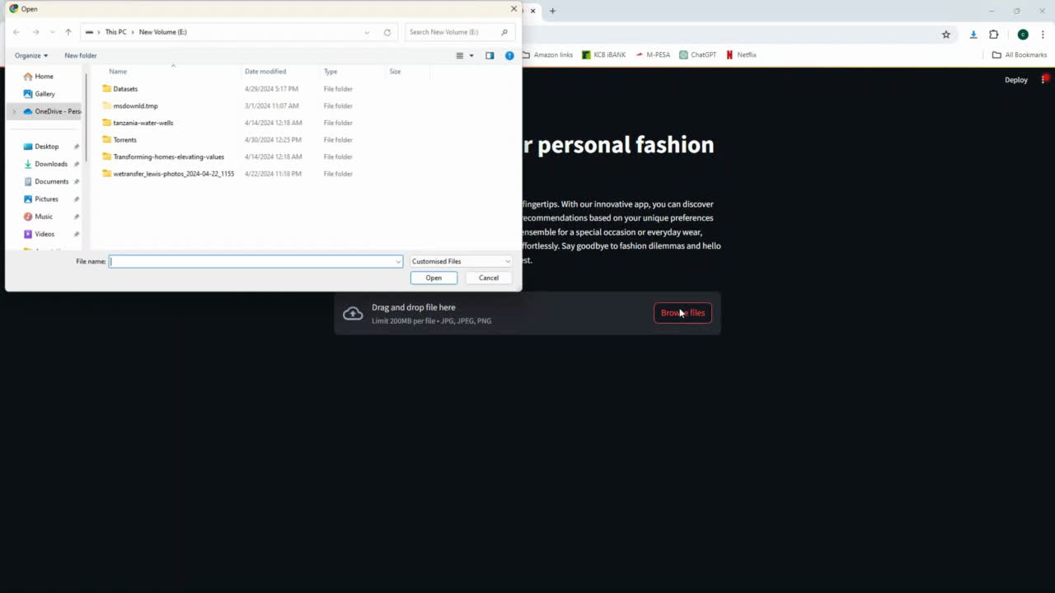

Slide 6
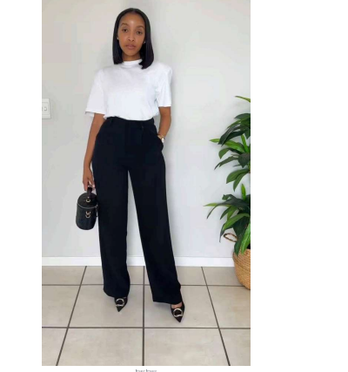
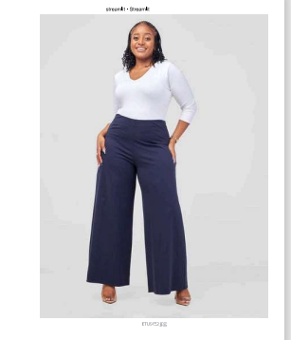
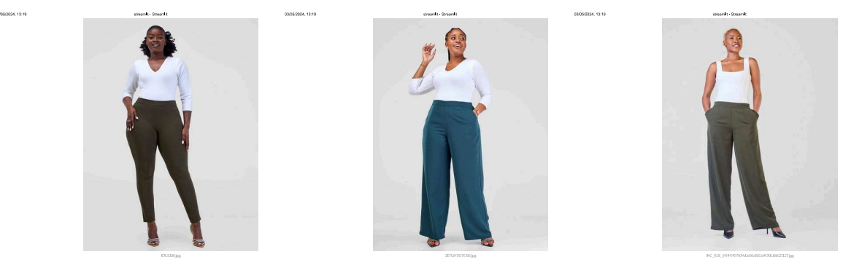
Sample of user upload
The model used are VGG16,resnet and CNN
similar recommended items

Slide 7
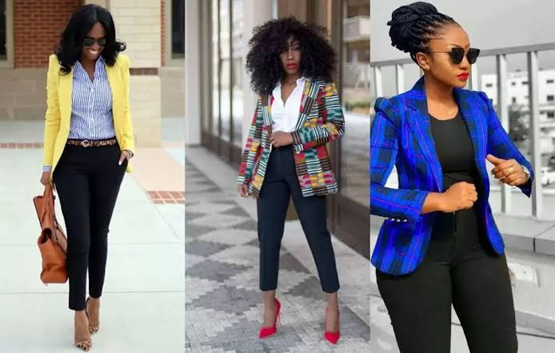
CONCLUSION
We have showcased the integration of machine learning models (e.g., KNN, VGG16/ResNet) with web deployment technologies (Streamlit) to create a user-friendly fashion recommendation system.

Slide 8
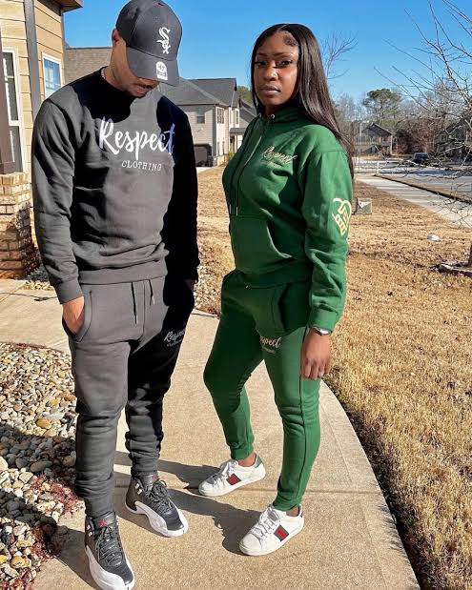
RECOMENDATIONS
Enhance recommendation algorithm
Incorporate user feedback for personalized recommendations
Optimize application performance
Improve user interface with additional features and refined layout
Continuous monitoring and updates for effectiveness and relevance

Slide 9
THANK YOU

